Slide 1

SQL INJECTION DETECTION USING MACHINE LEARNING
GUIDE : DR. MICHAEL AROCK
NAME : PRITESH KUMRAWAT
ROLL NO. 205124070

Slide 2
What is SQL Injection ?
SQL Injection (SQLi) is a type of web security vulnerability that allows attackers to inject malicious SQL code into a query, enabling them to access, modify, or delete data in a database by manipulating user input fields.
Why SQL Injection is Dangerous ?
Steals Data: Hackers can read private or sensitive information from the database.
Bypasses Login: Allows access to accounts without needing the correct password.
Changes Information: Attackers can update or insert fake data into the system.
Deletes Records: Can remove important data using harmful SQL commands.
Gains Extra Access: May give attackers admin rights or hidden controls.
Reveals System Info: Shows database details through error messages.

Slide 3
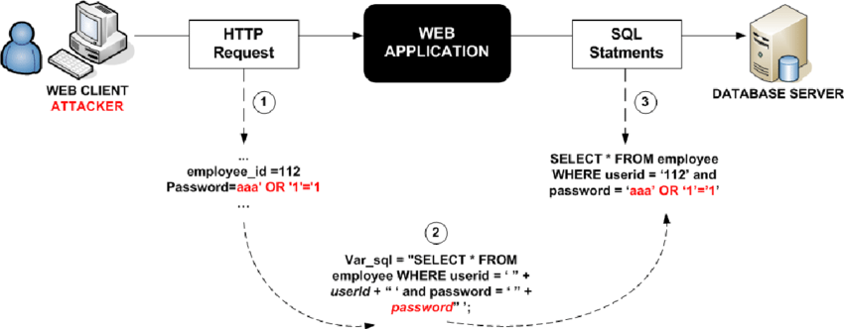
How SQL Injection works

Slide 4
Example
INPUT : ' OR 1=1 –
This turns a query like: SELECT * FROM users WHERE username = 'input’
INTO : SELECT * FROM users WHERE username = '' OR 1=1 --’
Which always returns true, bypassing login.

Slide 5
Types of SQL Injection
Type | Description | Example
Tautology | Bypasses login using true conditions | ' OR '1'='1
Union-based | Extracts data from other tables | ' UNION SELECT ...
Comment-based | Hides payload using SQL comments | ' OR 1=1 --
Encoded Input | Uses encoded characters for injection | %27 OR 1=1 --
Time-based | Delays response to leak data | ' OR SLEEP(5)--
Error-based | Forces DB errors to expose info | ' AND 1=@@version--
Special Chars | Ends query, adds malicious SQL | '; DROP TABLE users;--

Slide 6
Recent SQL Injection attacks on Indian websites
Year | Target | Type of SQLi | Impact
2025 | Tamil Nadu Govt Portal | Time-based Blind SQLi | ~1 million Aadhaar, student, and user records leaked
2025 | Undisclosed .gov.in Site | Boolean, UNION, Time-based | Millions of Aadhaar + banking records exposed
2024 | Assam State Exam Portal | UNION-based SQLi | ~1.1 million job seekers' PII (name, Aadhaar, caste)
2023 | IGNOU Student Portal | SQLi on modules | ~1 million student records potentially exposed
2018 | BSNL Subdomain | Classic SQLi | ~47,000 employee credentials leaked
2016 | IRCTC (Indian Railways) | Suspected SQLi/API flaw | ~2 lakh passenger records leaked

Slide 7
Solution of SQL Injection Attacks
Input Validation: Rejects dangerous or malformed inputs.
Parameterized Queries: Prevents SQL code from mixing with user input.
Stored Procedures: Reduces direct SQL exposure.
Web Application Firewalls (WAFs): Blocks known attack patterns.
Modern approach to solve this problem
Pattern Extraction: Normalizes SQL queries into structured tokens
ML Classification: Random Forest model detects injection attempts.
Real-Time Detection: Flags unsafe queries instantly in the web interface.
Admin Tools: Logs queries, exports reports, and monitors attack trends.
Obfuscation Handling: Catches encoded, hidden, or indirect payloads.

Slide 8
SQL Injection Detection using Machine Learning
Flow of the Project
User input
Pre-processing
Model prediction
(Safe/Attack)
Admin - login
Dashboard
(pdf export)

Slide 9







SQL Injection Detection using Machine Learning
Technologies Used in this Project
Python : Core programming language for backend and ML logic
Scikit-learn : Random Forest model and vectorization with CountVectorizer
joblib : Saving and loading the trained ML model
Regex (re) : Pattern extraction from SQL queries
Flask : Web framework for query input and prediction interface
xhtml2pdf : PDF export for admin reports
PyWebView : GUI integration to wrap Flask as a desktop app
HTML, CSS, Jinja2 : Frontend for user interface and admin dashboard

Slide 10

SQL Injection Detection using Machine Learning
How this project solve the problem
Detects injection attempts in real-time
Catches obfuscated or encoded SQLi payloads
Learns patterns, not just fixed rules
Adds an adaptive layer of defense

Slide 11
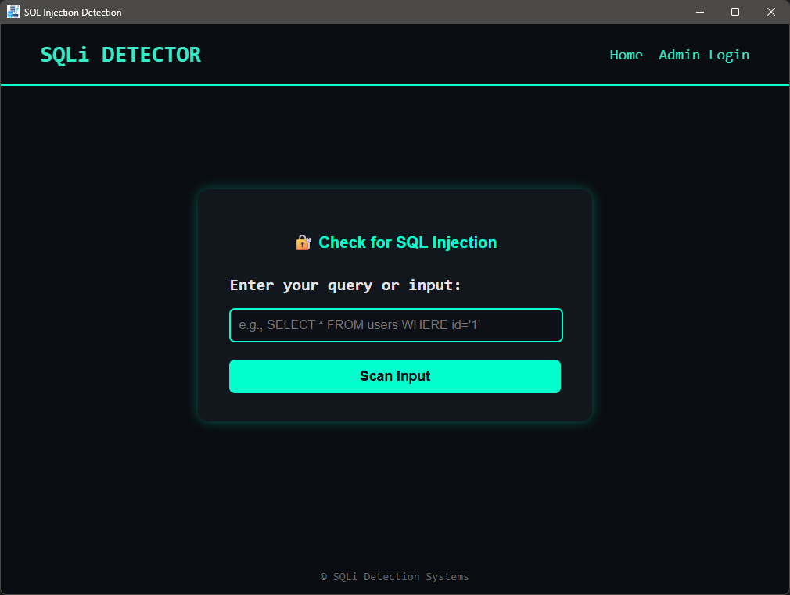
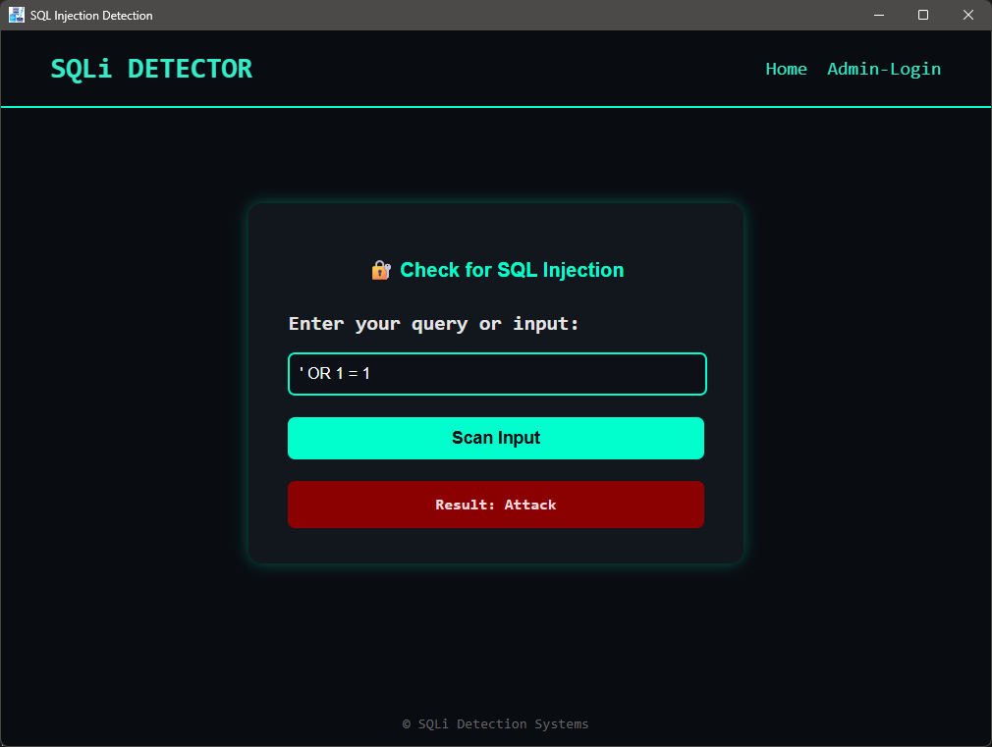
SQL Injection Detection using Machine Learning
Screenshots
User interface for SQL query
SQL Injection Attack

Slide 12
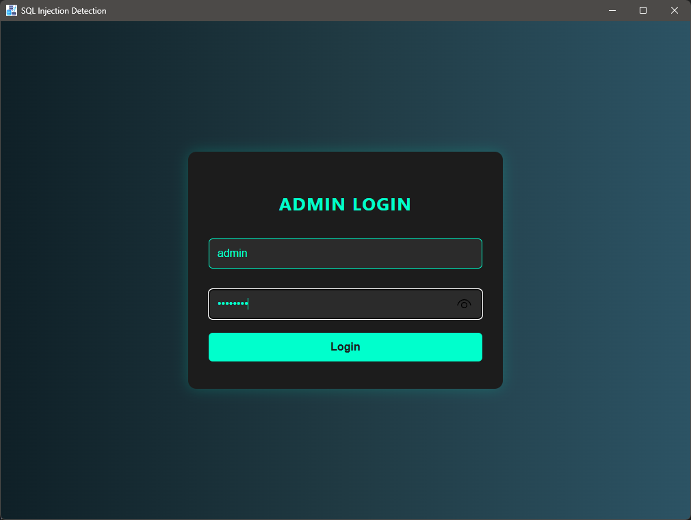
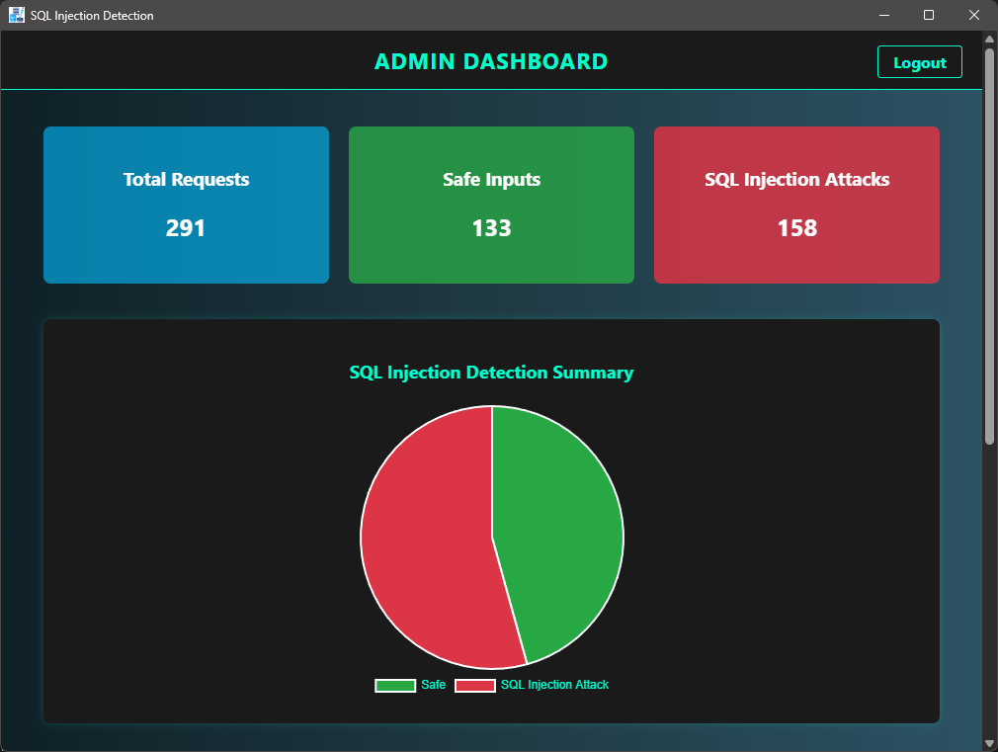
SQL Injection Detection using Machine Learning
Screenshots
Admin login
Dashboard for admin

Slide 13
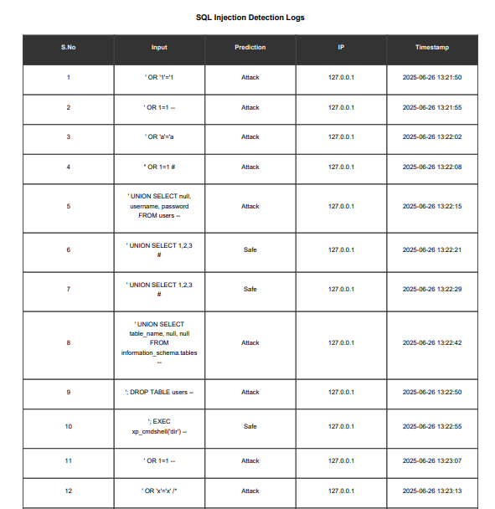
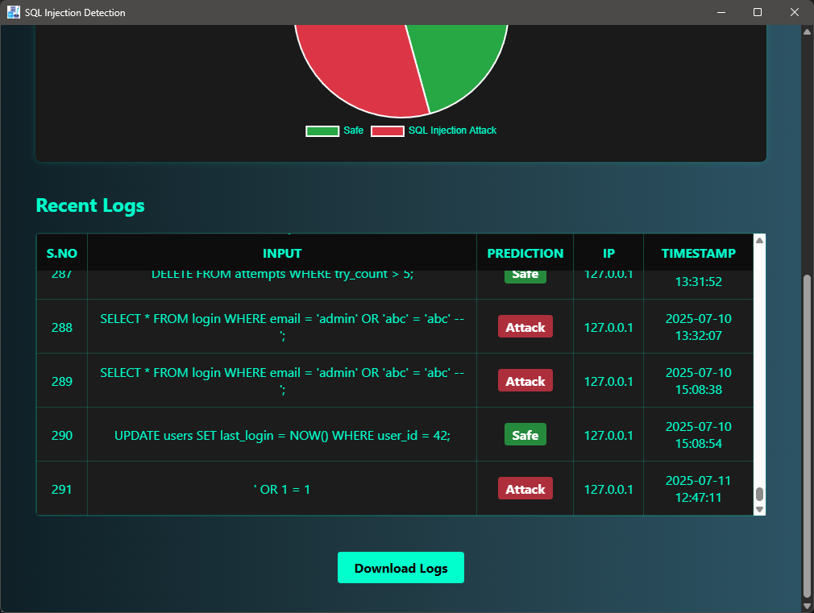
SQL Injection Detection using Machine Learning
Screenshots
Dashboard – logs with download option
Output of pdf file

Slide 14
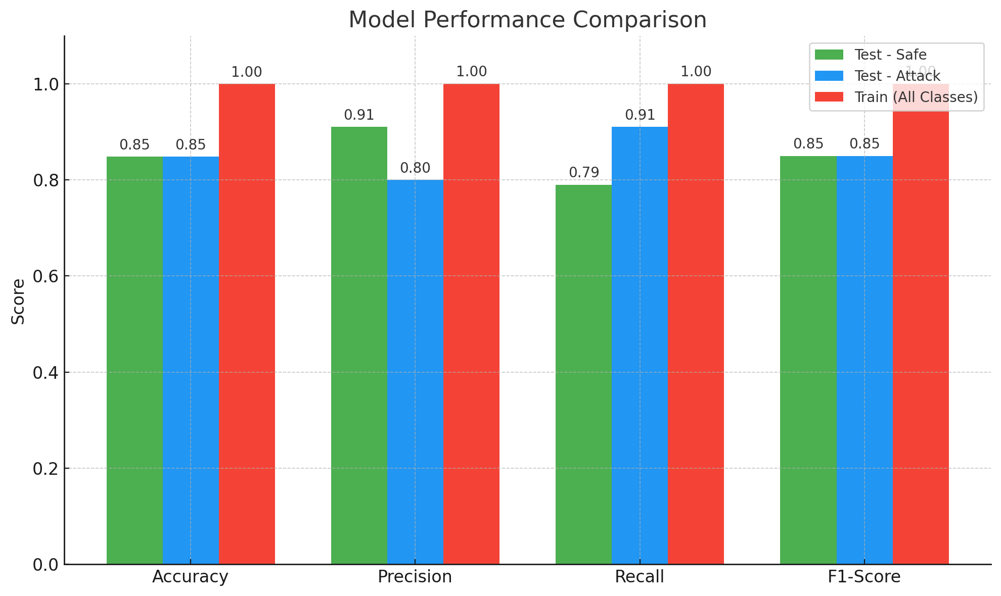
SQL Injection Detection using Machine Learning
Experimental Results
Test Results:
Accuracy: 84.8%
Safe Precision/Recall: 0.91 / 0.79
Attack Precision/Recall: 0.80 / 0.91
F1-Score (both classes): 0.85
Training Results:
Accuracy: 99.95%
All metrics (Precision, Recall, F1-score): 1.00 for both classes

Slide 15

SQL Injection Detection using Machine Learning
Future Inhancments
Integrate with Web Application Firewalls (WAFs) for real-time query blocking.
Upgrade to LSTM/GRU for deeper pattern learning.
Add advanced logging: geo-tracking, login attempts, user behavior.
Enable automatic model retraining from log data.
Convert system to an API.

Slide 16
THANK-YOU

